Slide 1
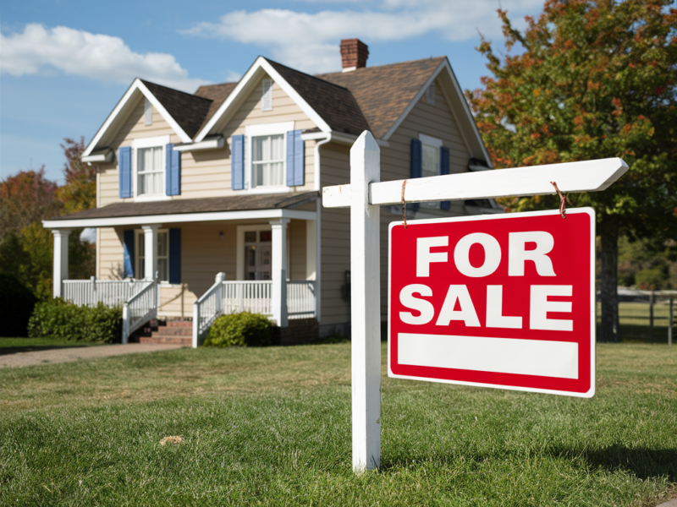
Data-Driven Real Estate:
A Machine Learning Solution
Tanmay Bhongale
Aditya Jadhav
Praful Tikkas

Slide 2


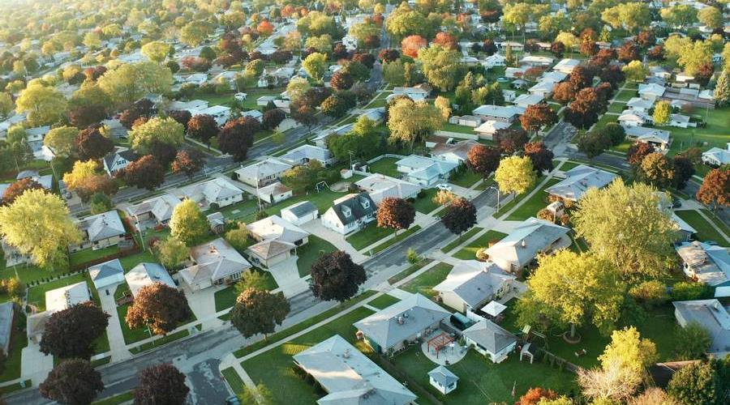
Agenda
Transforming Property Valuation with Data
The Data Problem: Garbage In, Garbage Out -
Domain-Aware Data Cleaning & Feature Creation
Model Performance: Simplicity Outperforms Complexity
From User Click to Price Estimate
Ready for Use & Future Growth
Delivering a Reliable, Practical AI Solution

Slide 3
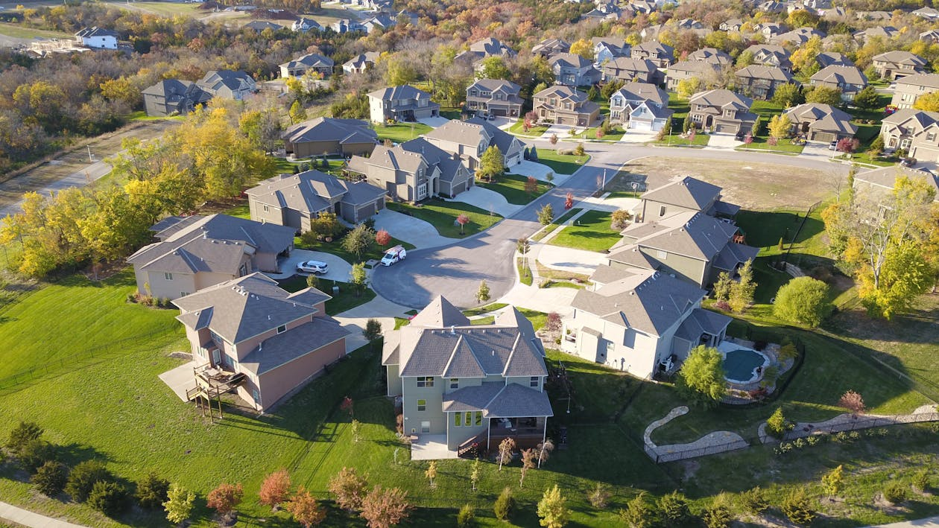


Transforming Property Valuation with Data
Key Achievements:
  High Accuracy: 84.5% R² Score with a simple, interpretable model.
  Robust Data Pipeline: Cleansed 13K+ listings to 7.2K high-quality samples.
  Deployed Solution: Interactive web app for instant, user-friendly predictions.
  Domain-Integrated: Built with real-world business logic at its core.
Core Value: Provides data-driven, consistent, and transparent price estimates for buyers, sellers, and agents.
Notes:
"We built a system that gives instant price estimates for Bangalore homes. Our big wins: 85% accuracy, a super-clean dataset, and a ready-to-use app. The core value? Data-driven transparency for buyers, sellers, and agents."

Slide 4
The Data Problem: Garbage In, Garbage Out
Before:
      size: "2 BHK", "3 Bedroom", "4BHK"
      total_sqft: "1200-1800", "2100 sq. meter", "3.5"
      location: 1306 unique, sparse values
      society: 41% missing
      Result: Unreliable models, hidden biases.
After:
    BHK: 2 (numeric)
    Total_Sqft: 1500 (standardized)
    Location: 244 optimized categories
    Price_per_sqft: 5500 (new feature)
    Result: 7,251 high-integrity samples.
Notes:
"We started with messy listings: sizes like '2 BHK', areas like '1200-1800', and too many location names. This 'garbage' data would have made a bad model. Our first job was to clean it up."

Slide 5
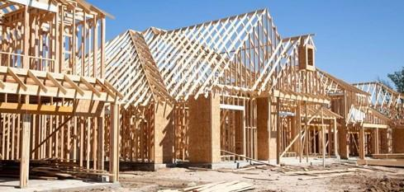
Domain-Aware Data Cleaning & Feature Creation
  Feature Engineering:
  Extract numeric BHK.
    Standardize Square Footage.
    Create Price_per_sqft for normalization.
    Optimize Location (group rare ones).
  Intelligent Outlier Removal (4 Layers):
    Physical: Min. 300 sqft/bedroom.
    Statistical: Price/sqft within 1 std dev.
    Logical: Size vs. Price consistency.
    Domain: Bathroom-to-Bedroom ratio.
Impact: Removed 45.6% of data as outliers/errors, ensuring model learns only valid patterns.
Notes:
"We didn't just use math; we used real estate rules. We enforced minimum space per bedroom and logical bathroom counts. This removed almost half the data as errors, but what remained was high-quality and trustworthy."

Slide 6
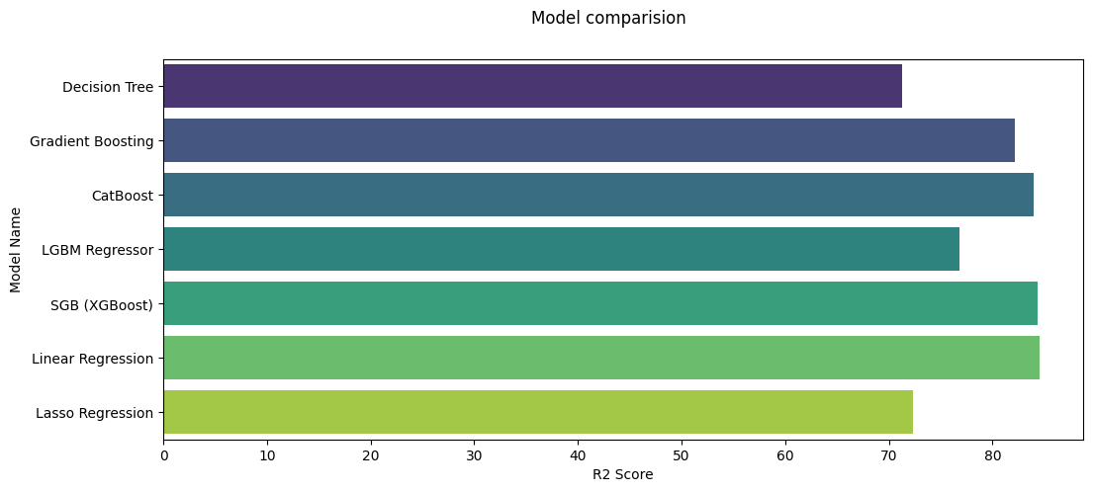
Model Performance: Simplicity Outperforms Complexity
Model Name | R2 Score
Decision Tree | 73.526
Gradient Boosting | 82.1068
CatBoost | 83.9582
LGBM Regressor | 76.7908
SGB (XGBoost) | 84.3597
Linear Regression | 84.5228
Lasso Regression | 72.3778
Notes:
"We tested many advanced models. But look here—the simple Linear Regression model (green bar) won. It was more accurate than complex ones like XGBoost. This chart shows the direct comparison."

Slide 7
Model Performance: Simplicity Outperforms Complexity
Key Finding:
  🥇 Winner: Linear Regression (84.52% R²)
  🥈 Runner-up: XGBoost (84.36% R²)
Insight Box: "Thorough data cleaning revealed strong linear relationships. The simplest, most interpretable model delivered the best performance."
Notes:
"Why did simple win? Because our cleaning was so effective. It revealed clear, linear patterns between features and price. This is great—it means our model is both accurate and easy to understand."

Slide 8
From User Click to Price Estimate
User Input
Preprocessing & Encoding
Feature Vector
Trained Linear Model
Prediction & Post-Processing
Output Display
Notes:
"Here's how it works for a user: 1) They choose inputs in the app. 2) The system encodes them like the model expects. 3) The model predicts. 4) We add market insights (like 'Premium location'). It takes less than 2 seconds."

Slide 9


Ready for Use & Future Growth
Deployment Ready:
  Requirements: Python, Streamlit, model files.
  Structure: Simple, modular files (app.py, model.pkl, etc.).
  Performance: <2 sec response, 84.5% accuracy.
Scalability Pathways:
  Add Cities: Repeat pipeline for new data.
  Enhance Models: Incorporate temporal trends.
  Advanced Features: Integrate amenities, images.
Notes:
"The app is live and ready. It's also built to grow. We can add new cities with the same pipeline or new features like amenities. The foundation is strong for future expansion."

Slide 10
Delivering a Reliable, Practical AI Solution
Success Metrics:
  Technical: >84% R², 45.6% noise removed.
  Business: Intuitive app, 244 locations covered.
Core Innovations:
  Domain-First Cleaning: Real estate rules > pure statistics.
  Interpretable AI: Chose explainable, high-performing model.
  End-to-End Product: From raw CSV to live web app.
  User-Centric Design: Built for usability, not just accuracy.
Notes:
"To wrap up: We delivered a practical tool, not just an experiment. Our key innovation was putting real estate knowledge first. The result is a reliable, explainable AI solution that anyone can use to make better property decisions."

Slide 11




Thank you
Tanmay bhongale |Praful Tikkas | Aditya Jadhav

